Slide 1
Module II
Transaction System, Testing of
Serializability, Serializability of Schedules, Conflict & View Serializable
Schedule, Recoverability, Recovery from Transaction Failures, Log Based
Recovery, Deadlock Handling.

Slide 2
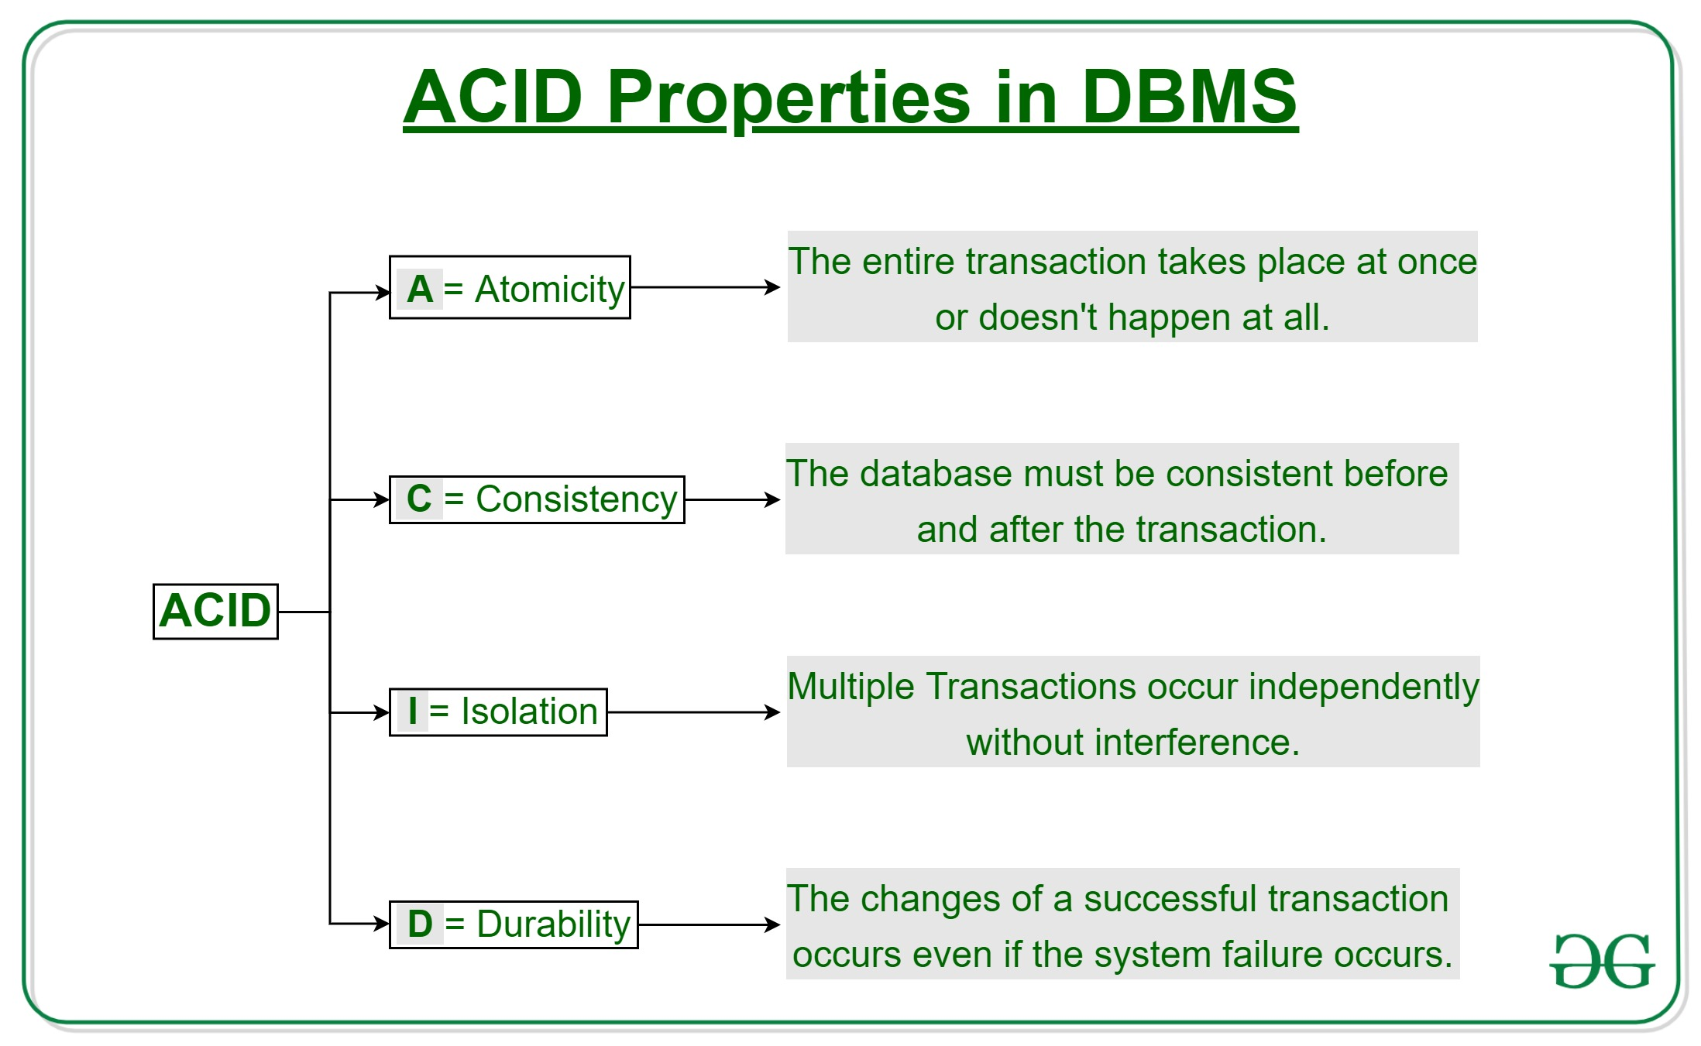
Introduction, Desirable Properties of Transactions
Transaction
  Describes local unit of database processing
In order to maintain consistency in a database, before and after the transaction, certain properties are followed. These are called ACID properties.
Property Responsibility for maintaining properties
Atomicity: Transaction Manager
Consistency: Application programmer
Isolation: Concurrency Control Manager
Durability: Recovery Manager
Notes:
A transaction is a single logical unit of work that accesses and possibly modifies the contents of a database. Transactions access data using read and write operations. In order to maintain consistency in a database, before and after the transaction, certain properties are followed. These are called ACID properties.
A transaction can be defined as a group of tasks. A single task is the minimum processing unit which cannot be divided further. A transaction is a very small unit of a program and it may contain several lowlevel tasks. A transaction in a database system must maintain Atomicity, Consistency, Isolation, and Durability − commonly known as ACID properties − in order to ensure accuracy, completeness, and data integrity.
Atomicity:
By this, we mean that either the entire transaction takes place at once or doesn’t happen at all. There is no midway i.e. transactions do not occur partially. Each transaction is considered as one unit and either runs to completion or is not executed at all. It involves the following two operations.
—Abort: If a transaction aborts, changes made to the database are not visible.
—Commit: If a transaction commits, changes made are visible.
Atomicity is also known as the ‘All or nothing rule’.
Consistency:
This means that integrity constraints must be maintained so that the database is consistent before and after the transaction. It refers to the correctness of a database. Referring to the example above,
Isolation:
This property ensures that multiple transactions can occur concurrently without leading to the inconsistency of the database state. Transactions occur independently without interference. Changes occurring in a particular transaction will not be visible to any other transaction until that particular change in that transaction is written to memory or has been committed. This property ensures that the execution of transactions concurrently will result in a state that is equivalent to a state achieved these were executed serially in some order.
Durability:
This property ensures that once the transaction has completed execution, the updates and modifications to the database are stored in and written to disk and they persist even if a system failure occurs. These updates now become permanent and are stored in non-volatile memory. The effects of the transaction, thus, are never lost.

Slide 3
Desirable Properties of Transactions (cont’d.)
Levels of isolation
  Level 0 isolation does not overwrite the dirty reads of higher-level transactions
  Level 1 isolation has no lost updates
  Level 2 isolation has no lost updates and no dirty reads
  Level 3 (true) isolation has repeatable reads
Notes:
There have been attempts to define the level of isolation of a transaction. A transaction is said to have level 0 (zero) isolation if it does not overwrite the dirty reads of higher-level transactions. Level 1 (one) isolation has no lost updates, and level 2 isolation has no lost updates and no dirty reads. Finally, level 3 isolation (also called true isolation) has, in addition to level 2 properties, repeatable reads.9

Slide 4
20.1 Introduction to Transaction Processing
Single-user DBMS
  At most one user at a time can use the system
  Example: home computer
Multiuser DBMS
  Many users can access the system (database) concurrently
  Example: airline reservations system

Slide 5
Introduction to Transaction Processing (cont’d.)
Multiprogramming
  Allows operating system to execute multiple processes concurrently
  Multiple users can access databases—and use computer systems—simultaneously because of the concept of multiprogramming, which allows the operating system of the computer to execute multiple programs—or processes—at the same time.
  Executes commands from one process, then suspends that process and executes commands from another process, etc.

Slide 6
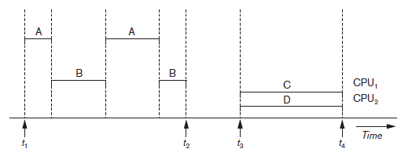
Introduction to Transaction Processing (cont’d.)
Interleaved processing
Parallel processing
  Processes C and D in figure below
Figure 20.1 Interleaved processing versus parallel processing of concurrent transactions
Notes:
multiprogramming operating systems execute some commands from one process, then suspend that process and execute some commands from the next process, and so on. A process is resumed at the point where it was suspended whenever it gets its turn to use the CPU again. Hence, concurrent execution of processes is actually interleaved, as illustrated in Figure 20.1, A and B, executing concurrently in an interleaved fashion. Interleaving keeps the CPU busy when a process requires an input or output (I/O) operation, such as reading a block from disk. The CPU is switched to execute another process rather than remaining idle during I/O time. Interleaving also prevents a long process from delaying other processes.

Slide 7
Transactions
Transaction: an executing program
  Forms logical unit of database processing
Begin and end transaction statements
  Specify transaction boundaries
Read-only transaction
Read-write transaction
Notes:
A transaction is an executing program that forms a logical unit of database processing. A transaction includes one or more database access operations—these can include insertion, deletion, modification, or retrieval operations. The database operations that form a transaction can either be embedded within an application program or they can be specified interactively via a high-level query language such as SQL. One way of specifying the transaction boundaries is by specifying explicit begin transaction and end transaction statements in an application program; in this case, all database access operations between the two are considered as forming one transaction. A single application program may contain more than one transaction if it contains several transaction boundaries. If the database operations in a transaction do not update the database but only retrieve data, the transaction is called a read-only transaction; otherwise it is known as a read-write transaction.

Slide 8
Database Items
Database represented as collection of named data items
Size of a data item called its granularity
Data item
  Record
  Disk block
  Attribute value of a record
Transaction processing concepts independent of item granularity
Notes:
The database model that is used to present transaction processing concepts is quite simple when compared to the data models that we discussed earlier in the book, such as the relational model or the object model. A database is basically represented as a collection of named data items. The size of a data item is called its granularity. A data item can be a database record, but it can also be a larger unit such as a whole disk block, or even a smaller unit such as an individual field (attribute) value of some record in the database. The transaction processing concepts we discuss are independent of the data item granularity (size) and apply to data items in general. Each data item has a unique name, but this name is not typically used by the programmer; rather, it is just a means to uniquely identify each data item. For example, if the data item granularity is one disk block, then the disk block address can be used as the data item name. Using this simplified database model, the basic database access operations that a transaction can include are as follows: ■ read_item(X). Reads a database item named X into a program variable. To simplify our notation, we assume that the program variable is also named X. ■ write_item(X). Writes the value of program variable X into the database item named X.

Slide 9
Read and Write Operations
read_item(X)
  Reads a database item named X into a program variable.
    Find the address of the disk block that contains item X.
    Copy that disk block into a buffer in main memory.
    Copy item X from the buffer to the program variable named X.
write_item(X)
  Writes the value of program variable X into the database item
    Find the address of the disk block that contains item X.
    Copy that disk block into a buffer in main memory.
    Copy item X from the program variable named X into its correct location in the buffer.
    Store the updated block from the buffer back to disk.

Slide 10
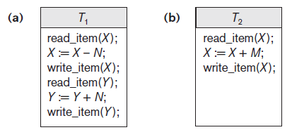
Read and Write Operations (cont’d.)
Read set of a transaction
  Set of all items read
Write set of a transaction
  Set of all items written
Figure 21.2 Two sample transactions (a) Transaction T1 (b) Transaction T2
Notes:
Several problems can occur when concurrent transactions execute in an uncontrolled manner. We illustrate some of these problems by referring to a much simplified airline reservations database in which a record is stored for each airline flight. Each record includes the number of reserved seats on that flight as a named (uniquely identifiable) data item, among other information. Figure 21.2(a) shows a transaction T1 that transfers N reservations from one flight whose number of reserved seats is stored in the database item named X to another flight whose number of reserved seats is stored in the database item named Y. Figure 21.2(b) shows a simpler transaction T2 that just reserves M seats on the first flight (X) referenced in transaction T1. 2 To simplify our example, we do not show additional portions of the transactions, such as checking whether a flight has enough seats available before reserving additional seats.
When a database access program is written, it has the flight number, flight date, and the number of seats to be booked as parameters; hence, the same program can be used to execute many different transactions, each with a different flight number, date, and number of seats to be booked. For concurrency control purposes, a transaction is a particular execution of a program on a specific date, flight, and number of seats. In Figure 21.2(a) and (b), the transactions T1 and T2 are specific executions of the programs that refer to the specific flights whose numbers of seats are stored in data items X and Y in the database. Next we discuss the types of problems we may encounter with these two simple transactions if they run concurrently.

Slide 11
Concurrency Control
Transactions submitted by various users may execute concurrently
  Access and update the same database items
  Some form of concurrency control is needed
The lost update problem
  Occurs when two transactions that access the same database items have operations interleaved
  Results in incorrect value of some database items

Slide 12
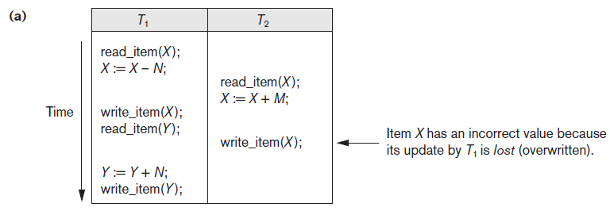
The Lost Update Problem
Figure 20.3 Some problems that occur when concurrent execution is uncontrolled (a) The lost update problem
Notes:
Suppose that transactions T1 and T2 are submitted at approximately the same time, and suppose that their operations are interleaved as shown in Figure 21.3(a); then the final value of item X is incorrect because T2 reads the value of X before T1 changes it in the database, and hence the updated value resulting from T1 is lost. For example, if X = 80 at the start (originally there were 80 reservations on the flight), N = 5 (T1 transfers 5 seat reservations from the flight corresponding to X to the flight corresponding to Y), and M = 4 (T2 reserves 4 seats on X), the final result should be X = 79. However, in the interleaving of operations shown in Figure 21.3(a), it is X = 84 because the update in T1 that removed the five seats from X was lost.

Slide 13
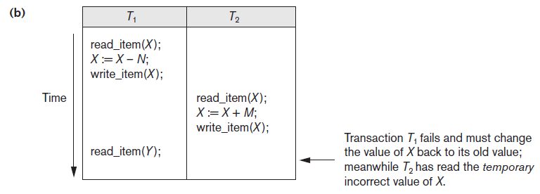
The Temporary Update (or Dirty Read) Problem
Figure 20.3 (cont’d.) Some problems that occur when concurrent execution is uncontrolled (b) The temporary update problem
Notes:
This problem occurs when one transaction updates a database item and then the transaction fails for some reason (see Section 21.1.4). Meanwhile, the updated item is accessed (read) by another transaction before it is changed back to its original value. Figure 21.3(b) shows an example where T1 updates item X and then fails before completion, so the system must change X back to its original value. Before it can do so, however, transaction T2 reads the temporary value of X, which will not be recorded permanently in the database because of the failure of T1. The value of item X that is read by T2 is called dirty data because it has been created by a transaction that has not completed and committed yet; hence, this problem is also known as the dirty read problem.

Slide 14
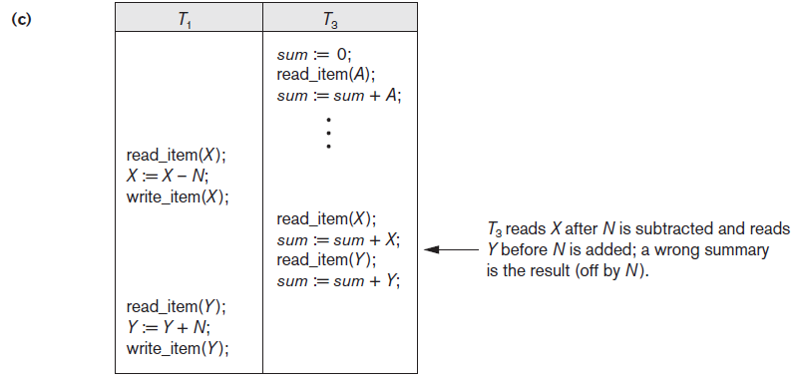
The Incorrect Summary Problem
Figure 20.3 (cont’d.) Some problems that occur when concurrent execution is uncontrolled (c) The incorrect summary problem
Notes:
If one transaction is calculating an aggregate summary function on a number of database items while other transactions are updating some of these items, the aggregate function may calculate some values before they are updated and others after they are updated. For example, suppose that a transaction T3 is calculating the total number of reservations on all the flights; meanwhile, transaction T1 is executing. If the interleaving of operations shown in Figure 21.3(c) occurs, the result of T3 will be off by an amount N because T3 reads the value of X after N seats have been subtracted from it but reads the value of Y before those N seats have been added to it.

Slide 15
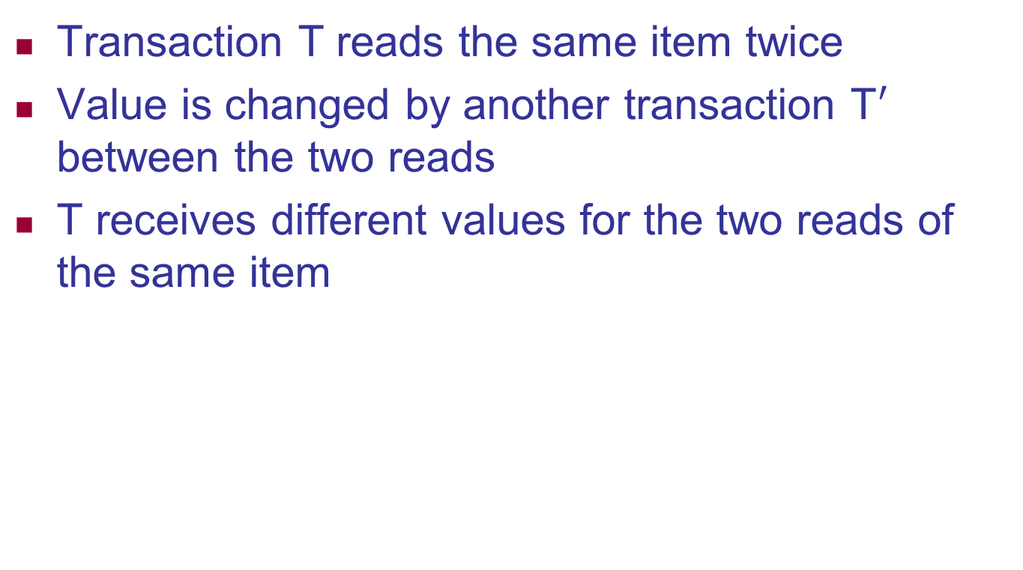
The Unrepeatable Read Problem
Transaction T reads the same item twice
Value is changed by another transaction T$′$ between the two reads
T receives different values for the two reads of the same item
Notes:
Another problem that may occur is called unrepeatable read, where a transaction T reads the same item twice and the item is changed by another transaction T between the two reads. Hence, T receives different values for its two reads of the same item. This may occur, for example, if during an airline reservation transaction, a customer inquires about seat availability on several flights. When the customer decides on a particular flight, the transaction then reads the number of seats on that flight a second time before completing the reservation, and it may end up reading a different value for the item.

Slide 16
Why Recovery is Needed
Committed transaction
  Effect recorded permanently in the database
Aborted transaction
  Does not affect the database
Types of transaction failures
  Computer failure (system crash)
  Transaction or system error
  Local errors or exception conditions detected by the transaction
Notes:
Whenever a transaction is submitted to a DBMS for execution, the system is responsible for making sure that either all the operations in the transaction are completed successfully and their effect is recorded permanently in the database, or that the transaction does not have any effect on the database or any other transactions. In the first case, the transaction is said to be committed, whereas in the second case, the transaction is aborted. The DBMS must not permit some operations of a transaction T to be applied to the database while other operations of T are not, because the whole transaction is a logical unit of database processing. If a transaction fails
after executing some of its operations but before executing all of them, the operations already executed must be undone and have no lasting effect.
A computer failure (system crash). A hardware, software, or network error occurs in the computer system during transaction execution. Hardware crashes are usually media failures—for example, main memory failure.
2. A transaction or system error. Some operation in the transaction may cause it to fail, such as integer overflow or division by zero. Transaction failure may also occur because of erroneous parameter values or because of a logical programming error.3 Additionally, the user may interrupt the transaction during its execution.
3. Local errors or exception conditions detected by the transaction. During transaction execution, certain conditions may occur that necessitate cancellation of the transaction. For example, data for the transaction may not be found. An exception condition,4 such as insufficient account balance in a banking database, may cause a transaction, such as a fund withdrawal, to be
canceled. This exception could be programmed in the transaction itself, and in such a case would not be considered as a transaction failure.

Slide 17
Why Recovery is Needed (cont’d.)
Types of transaction failures (cont’d.)
  Concurrency control enforcement
  Disk failure
  Physical problems or catastrophes
System must keep sufficient information to recover quickly from the failure
  Disk failure or other catastrophes have long recovery times
Notes:
Concurrency control enforcement. The concurrency control method (see Chapter 22) may decide to abort a transaction because it violates serializability (see Section 21.5), or it may abort one or more transactions to resolve a state of deadlock among several transactions (see Section 22.1.3).
Transactions aborted because of serializability violations or deadlocks are typically restarted automatically at a later time.
Physical problems and catastrophes. This refers to an endless list of problems that includes power or air-conditioning failure, fire, theft, sabotage, overwriting disks or tapes by mistake, and mounting of a wrong tape by the operator.
Failures of types 1, 2, 3, and 4 are more common than those of types 5 or 6. Whenever a failure of type 1 through 4 occurs, the system must keep sufficient information to quickly recover from the failure. Disk failure or other catastrophic failures of type 5 or 6 do not happen frequently; if they do occur, recovery is a major task.

Slide 18
20.2 Transaction and System Concepts
System must keep track of when each transaction starts, terminates, commits, and/or aborts
  BEGIN_TRANSACTION
  READ or WRITE
  END_TRANSACTION
  COMMIT_TRANSACTION
  ROLLBACK (or ABORT)

Slide 19
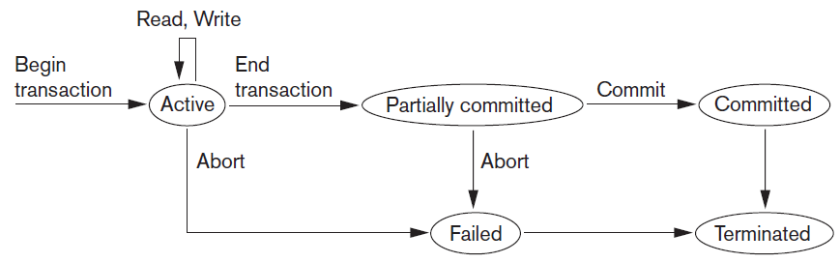
Transaction and System Concepts (cont’d.)
Figure 20.4 State transition diagram illustrating the states for transaction execution

Slide 20
20.4 Characterizing Schedules Based on Recoverability
Schedule or history
  A schedule (or history) S of n transactions T1, T2, ..., Tn is an ordering of the operations of the transactions.
  Operations from different transactions can be interleaved in the schedule
  Eg:
    T1: O1 O2
    T2: P1 P2
    S1: O1 O2 P1 P2, S2: P1 P2 O1 O2, S3:O1 P1 O2 P2, S4: O1 P1 P2 O2, S5: P1 O1 O2 P2, S6:P1 O1 P2 O2
A schedule (or history) S of n transactions T1, T2, ..., Tn is an ordering of the operations of the transactions, which means
  For any two operations in the schedule, one must occur before the other
Notes:
A schedule (or history) S of n transactions T1, T2, ..., Tn is an ordering of the operations of the transactions. Operations from different transactions can be interleaved in the schedule S. However, for each transaction Ti that participates in the schedule S, the operations of Ti in S must appear in the same order in which they occur in Ti. The order of operations in S is considered to be a total ordering, meaning that for any two operations in the schedule, one must occur before the other. It is possible theoretically to deal with schedules whose operations form partial orders (as we discuss later), but we will assume for now total ordering of the operations in a schedule.

Slide 21


Types of Schedules
Serial Schedule
  If we don’t have any interleaving then that type of schedule is called serial schedule
  When transactions are executing serially that always ensure the consistency
  If there are n-transactions in a schedule the possible number of serial schedule in n!.
  Eg:
    S1: R1(A)W1(A) R2(A)W2(A) [T1 -> T2]
    S2: R2(A)W2(A)R1(A)W1(A) [T2 -> T1]
    S3: R1(A)R2(A)W1(A)W2(A)
Serial
Schedules
Not Serial
Schedule

Slide 22
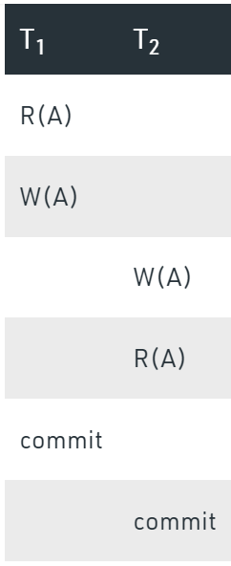
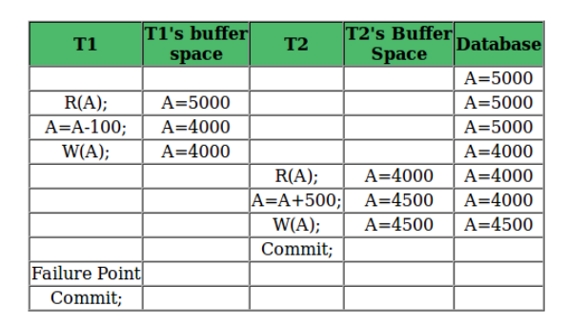
Types of Schedules
2. Complete Schedule:
A schedule is said to be complete if the last operation is either abort or commit.
Eg: R1(A) R2(A)W1(A)Commit W2(A)abort
3. Recoverable Schedule
Schedules in which transactions commit only after all transactions whose changes they read commit are called recoverable schedules.
i.e. This is a recoverable schedule since T1 commits before T2, that makes the value read by T2 correct.
Recoverable Schedule
Non Recoverable Schedule
Notes:
In other words, if some transaction Tj is reading value updated or written by some other transaction Ti, then the commit of Tj must occur after the commit of Ti

Slide 23
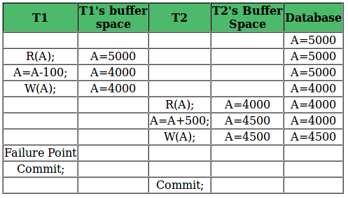
Types of Schedules
4. Cascading Aborts:
  If one transaction failure causes multiple transaction to rollback, it is called cascading rollback or cascading abort.
  Eg:
5. Cascadless Schedule:
    A schedule is said to be cascadeless, or to avoid cascading rollback, if every transaction in the schedule reads only items that were written by committed transactions. In this case, all items read will not be discarded, so no cascading rollback will occur.
6. Strict Schedule
  A schedule is strict if a value written by a transaction can not be read or over written by other transactions until the transaction is either commits or aborts.
Recoverable with Cascading Rollback:

Slide 24
Serializability
Serializable Schedule
  The types of schedules that are always considered to be correct when concurrent transactions are executing. Such schedules are known as serializable schedules..
  The concept of serializability of schedules is used to identify which schedules are correct when transaction executions have interleaving of their operations in the schedules.
  A schedule S of n transactions is serializable if it is equivalent to some serial schedule of the same n transactions.
  Types
    Result equivalent
    Conflict equivalent or conflict serializable
    View equivalent or view serializable

Slide 25
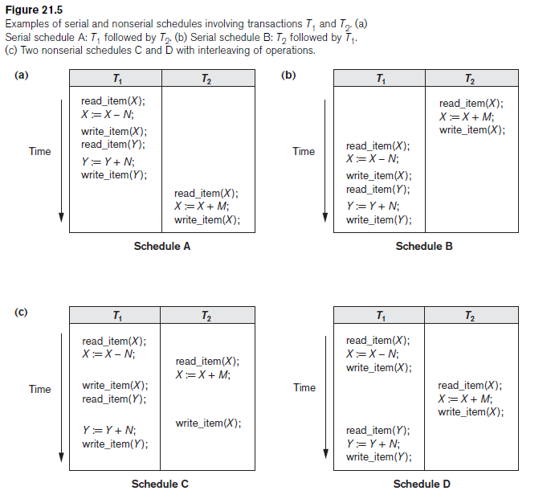

Slide 26
Characterizing Schedules Based on Recoverability (cont’d.)
Two conflicting operations in a schedule
  Operations belong to different transactions
  Operations access the same item X
  At least one of the operations is a write_item(X)
Two operations conflict if changing their order results in a different outcome
Read-write conflict
Write-write conflict

Slide 27
Characterizing Schedules Based on Recoverability (cont’d.)
Recoverable schedules
  Recovery is possible
Nonrecoverable schedules should not be permitted by the DBMS
No committed transaction ever needs to be rolled back
Cascading rollback may occur in some recoverable schedules
  Uncommitted transaction may need to be rolled back

Slide 28
Characterizing Schedules Based on Recoverability (cont’d.)
Cascadeless schedule
  Avoids cascading rollback
Strict schedule
  Transactions can neither read nor write an item X until the last transaction that wrote X has committed or aborted
  Simpler recovery process
    Restoration

Slide 29
20.5 Characterizing Schedules Based on Serializability
Serializable schedules
  Always considered to be correct when concurrent transactions are executing
  Places simultaneous transactions in series
    Transaction T₁ before T₂, or vice versa

Slide 30
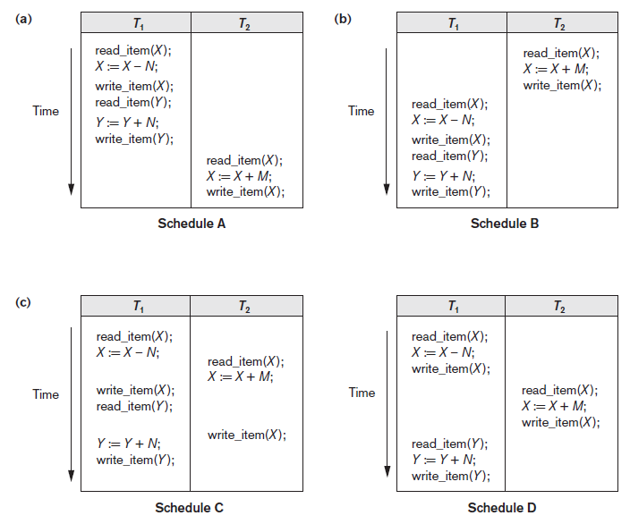
Figure 20.5 Examples of serial and nonserial schedules involving transactions T1 and T2 (a) Serial schedule A: T1 followed by T2 (b) Serial schedule B: T2 followed by T1 (c) Two nonserial schedules C and D with interleaving of operations

Slide 31
Characterizing Schedules Based on Serializability (cont’d.)
Problem with serial schedules
  Limit concurrency by prohibiting interleaving of operations
  Unacceptable in practice
  Solution: determine which schedules are equivalent to a serial schedule and allow those to occur
Serializable schedule of n transactions
  Equivalent to some serial schedule of same n transactions

Slide 32
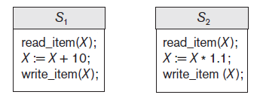
Characterizing Schedules Based on Serializability (cont’d.)
Result equivalent schedules
  Produce the same final state of the database
    For example, schedules S1 and S2 will produce the same final database state if they execute on a database with an initial value of X = 100; however, for other initial values of X, the schedules are not result equivalent.
    Cannot be used alone to define equivalence of schedules
Figure 20.6 Two schedules that are result equivalent for the initial value of X = 100 but are not result equivalent in general
Notes:
Notice that there are n! possible serial schedules of n transactions and many more possible nonserial schedules.
There are several ways to define schedule equivalence. The simplest but least satisfactory
definition involves comparing the effects of the schedules on the database.
Two schedules are called result equivalent if they produce the same final state of the database. However, two different schedules may accidentally produce the same final state. For example, in Figure 21.6, schedules S1 and S2 will produce the same final database state if they execute on a database with an initial value of X = 100; however, for other initial values of X, the schedules are not result equivalent. Additionally,
these schedules execute different transactions, so they definitely should not be considered equivalent. Hence, result equivalence alone cannot be used to define equivalence of schedules.

Slide 33
Characterizing Schedules Based on Serializability (cont’d.)
For two schedules to be equivalent, the operations applied to each data item affected by the schedules should be applied to that item in both schedules in the same order.
Two definitions of equivalence of schedules are generally used: conflict equivalence and view equivalence.
Conflict equivalence
  Relative order of any two conflicting operations is the same in both schedules
Conflict Serializable
  Schedule S is conflict serializable if it is conflict equivalent to some serial schedule S’.
Notes:
The definition of conflict equivalence of schedules is as follows: Two schedules are said to be conflict equivalent if the order of any two conflicting operations is the same in both schedules. Recall from Section 21.4.1 that two operations in a schedule are said to conflict if they belong to different transactions, access the same database item, and either both are write_item operations or one is a write_item and the other a
read_item. If two conflicting operations are applied in different orders in two schedules, the effect can be different on the database or on the transactions in the schedule, and hence the schedules are not conflict equivalent.
Using the notion of conflict equivalence, we define a schedule S to be conflict serializable12
if it is (conflict) equivalent to some serial schedule S. In such a case, we
can reorder the nonconflicting operations in S until we form the equivalent serial
schedule S. According to this definition, schedule D in Figure 21.5(c) is equivalent
to the serial schedule A in Figure 21.5(a). In both schedules, the read_item(X) of T2
reads the value of X written by T1, while the other read_item operations read the
database values from the initial database state.Additionally, T1 is the last transaction
to write Y, and T2 is the last transaction to write X in both schedules. Because A is a
serial schedule and schedule D is equivalent to A, D is a serializable schedule.
Schedule C in Figure 21.5(c) is not equivalent to either of the two possible serial
schedules A and B, and hence is not serializable. Trying to reorder the operations of
schedule C to find an equivalent serial schedule fails because r2(X) and w1(X) conflict,
which means that we cannot move r2(X) down to get the equivalent serial
schedule T1, T2. Similarly, because w1(X) and w2(X) conflict, we cannot move w1(X)
down to get the equivalent serial schedule T2, T1.

Slide 34
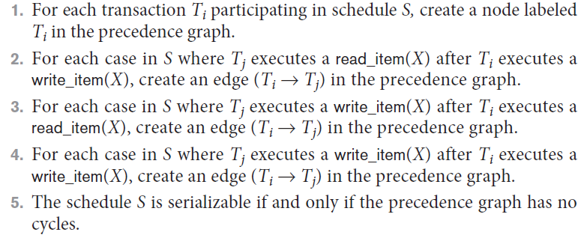
Characterizing Schedules Based on Serializability (cont’d.)
Testing for serializability of a schedule
Algorithm 20.1 Testing conflict serializability of a schedule S

Slide 35
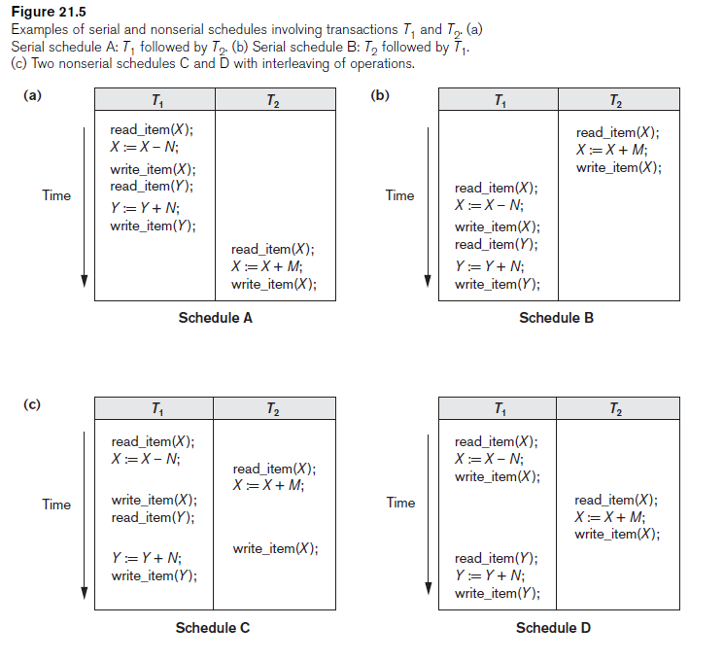
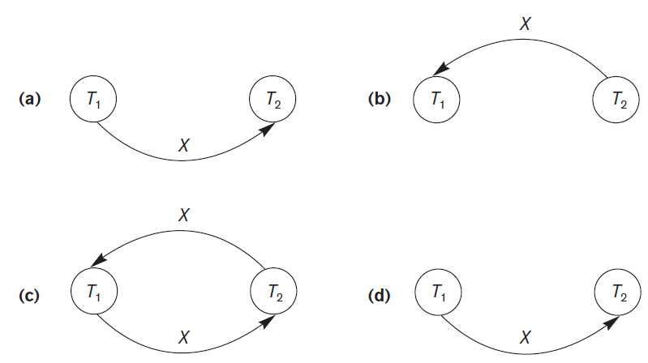
Characterizing Schedules Based on Serializability (cont’d.)
Figure 20.7 Constructing the precedence graphs for schedules A to D from Figure 21.5 to test for conflict serializability (a) Precedence graph for serial schedule A (b) Precedence graph for serial schedule B (c) Precedence graph for schedule C (not serializable) (d) Precedence graph for schedule D (serializable, equivalent to schedule A)

Slide 36
How Serializability is Used for Concurrency Control
Being serializable is different from being serial
Serializable schedule gives benefit of concurrent execution
  Without giving up any correctness
Difficult to test for serializability in practice
  Factors such as system load, time of transaction submission, and process priority affect ordering of operations
DBMS enforces protocols
  Set of rules to ensure serializability

Slide 37
View Equivalence and View Serializability
View equivalence of two schedules
  If Ti reads initial value of ‘A’ in S, then Ti should also read initial value of data item A in S’.
  If Tj produces final write operation of ‘A’ in S then Tj should also perform the final write operation of A in S’.
  If Tj reads a value produced by Ti in S then Tj must also read the value produced by Ti in S’.
View serializable schedule
  A schedule S is said to be view serializable if it is view equivalent to a serial schedule.
Notes:
The idea behind view equivalence is that, as long as each read operation of a transaction reads the result of the same write operation in both schedules, the write operations of each transaction must produce the same results. The read operations are hence said to see the same view in both schedules. Condition 3 ensures that the final write operation on each data item is the same in both schedules, so the database
state should be the same at the end of both schedules. A schedule S is said to be view serializable if it is view equivalent to a serial schedule.

Slide 38
View Equivalence and View Serializability (cont’d.)
Conflict serializability similar to view serializability if constrained write assumption (no blind writes) applies
Unconstrained write assumption
  Value written by an operation can be independent of its old value
Debit-credit transactions
  Less-stringent conditions than conflict serializability or view serializability

Slide 39
20.6 Transaction Support in SQL
No explicit Begin_Transaction statement
Every transaction must have an explicit end statement
  COMMIT
  ROLLBACK
Access mode is READ ONLY or READ WRITE
Diagnostic area size option
  Integer value indicating number of conditions held simultaneously in the diagnostic area

Slide 40
20.7 Summary
Single and multiuser database transactions
Uncontrolled execution of concurrent transactions
System log
Failure recovery
Committed transaction
Schedule (history) defines execution sequence
  Schedule recoverability
  Schedule equivalence
Serializability of schedules

